Slide 1


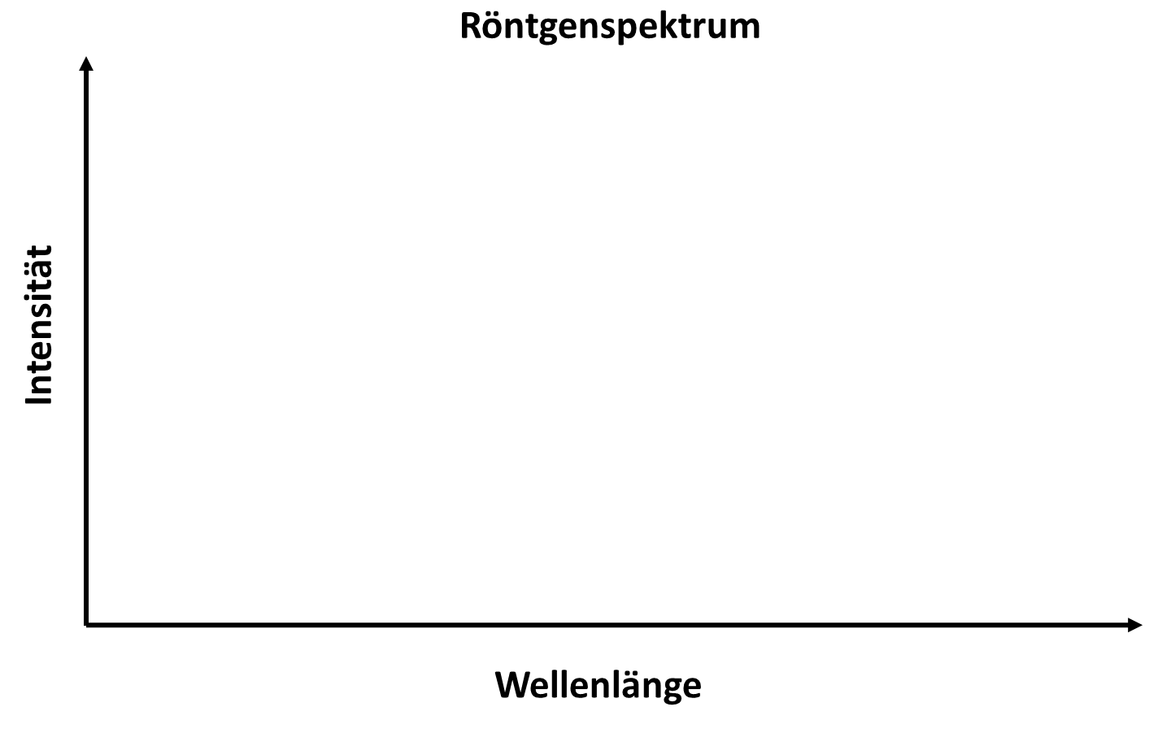
X-ray tube
Heating voltage
V
High voltage
V
X-ray spectrum
Intensity
Wavelength
Cathode
Anode

Slide 2

X-ray tube
Heating voltage
V
High voltage
V
X-ray spectrum
Electron cloud
Intensity
Wavelength
Cathode
Anode

Slide 3
X-ray tube
Heating voltage
V
High voltage
V
X-ray tube current
X-ray spectrum
Electron cloud
Intensity
Wavelength
Cathode
Anode
X-ray photons

Slide 4
X-ray tube
Heating voltage
V
High voltage
V
X-ray tube current
X-ray spectrum
Electron cloud
Intensity
Wavelength
Cathode
Anode
X-ray photons

Slide 5
X-ray tube
Heating voltage
V
High voltage
V
X-ray spectrum
Intensity
Wavelength
Cathode
Anode

